Slide 1



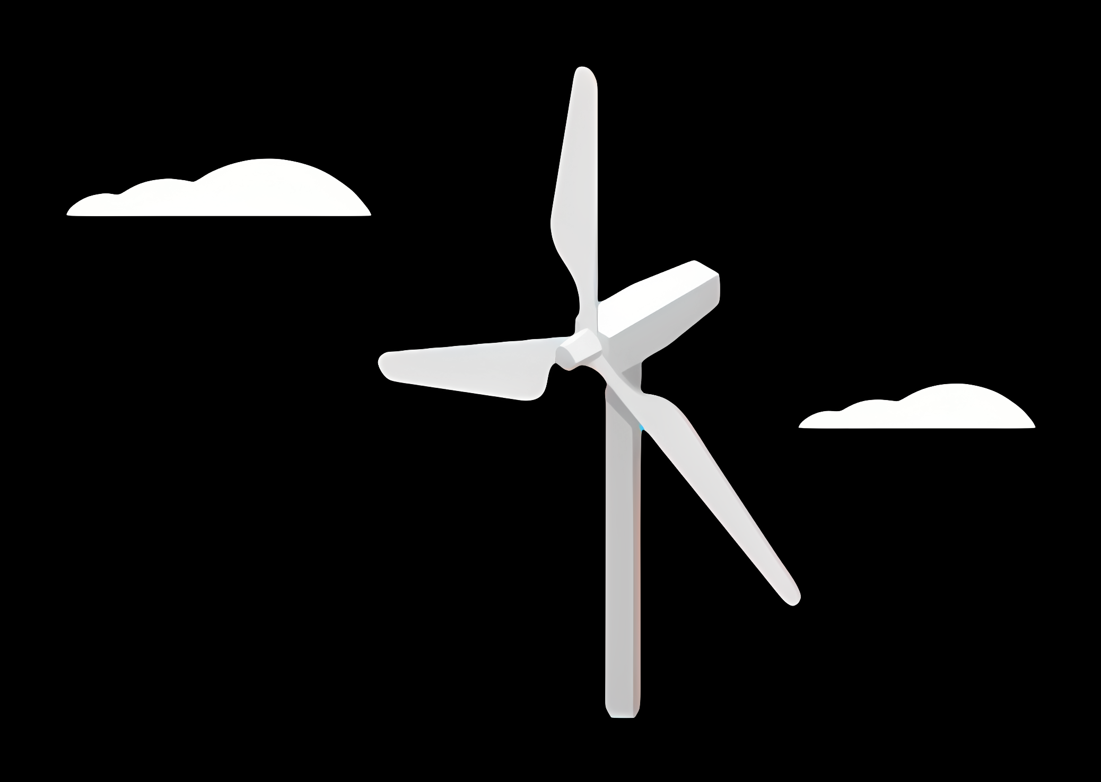
Weekly report: Load & Dynamics
Week number: 02
Date: 07/10/2025
Supervisor: Mr. Manjock
Group members: Md Aman
07/10/2025
Md Aman
Optimus Syria

Slide 2
Agenda
Concept behind DLC* 1.3 & 6.1 according to DNVGL-ST-0437:2016 / IEC 61400-1:2019
ETM & Normal Calculation
TurbSim
Estimated Loads for Optimus Syria based on statistics.
Connected Group & Future Plan
* DLC = Design Load Case
07/10/2025
Md Aman
Load & Dynamics Team/ Optimus Syria

Slide 3
DLC 1.3 & DLC 6.1
Design Load Case 1.3 from the DNVGL-ST-0437 / IEC 61400 wind turbine standard, which typically covers normal operation in extreme turbulent wind conditions.
Design Load Case 6.1 from the DNVGL-ST-0437 / IEC 61400 wind turbine standard, about parked turbine loads (when the turbine is not running).
Specifically: Extreme Wind Model (EWM) when the rotor is parked or idling.
Feature | DLC 1.3 | DLC 6.1
Turbine state | Operating, spinning, active control | Parked or idling, minimal control
Turbulence model | ETM (extreme turbulence) | EWM / ETM variant for park condition
Purpose | Extreme loads during operation | Extreme loads when not operating / safety in storm
Loads driven by | Mean + turbulence + dynamic response | Mostly high wind speeds and static pressure + wind excitation
07/10/2025
3
Load & Dynamics Team/ Optimus Syria

Slide 4
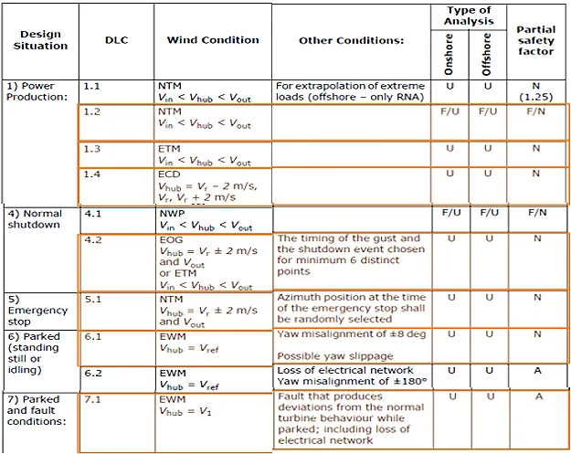
Load cases according to DNV-ST0437 load standard
Simulated load cases planned for this project
Source: DNVGL-ST-0437:2016
07/10/2025
4
Load & Dynamics Team/ Optimus Syria

Slide 5
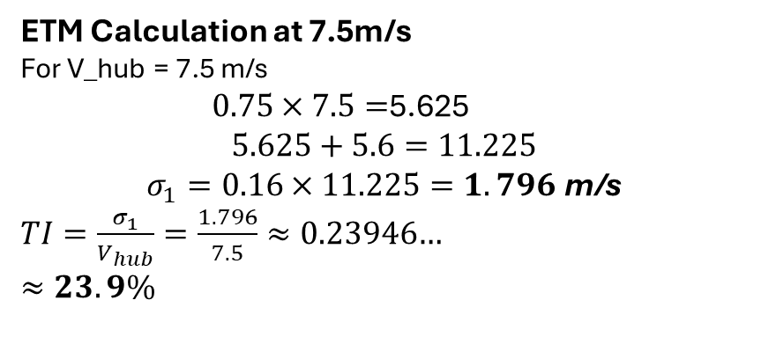
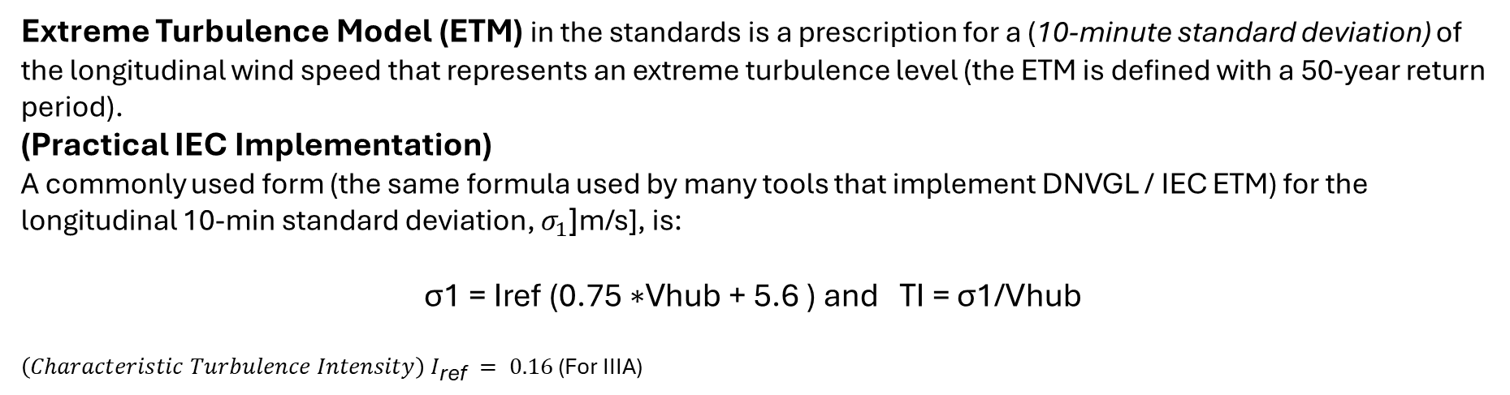
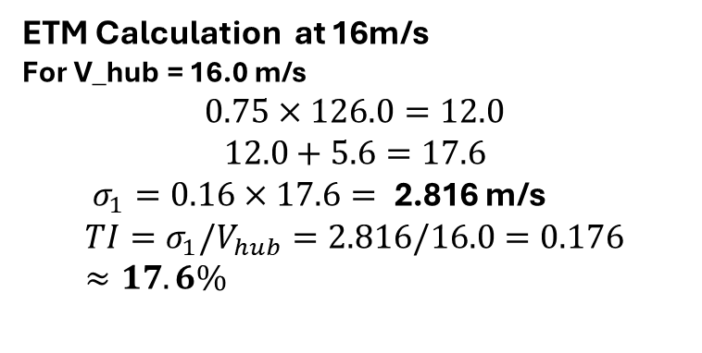
ETM & Normal Operation
Extreme Turbulence Model (ETM) in the standards is a prescription for a (10-minute standard deviation) of the longitudinal wind speed that represents an extreme turbulence level (the ETM is defined with a 50-year return period).
(Practical IEC Implementation) A commonly used form (the same formula used by many tools that implement DNVGL / IEC ETM) for the longitudinal 10-min standard deviation, $σ_{1}$[m/s], is:
$$\text{σ}\text{1} \text{​=} \text{Iref}\text{​ (}\text{0}\text{.}\text{75 }\text{∗}\text{Vhub}\text{​ + }\text{5}\text{.}\text{6 }\text{) }\text{and} \text{TI}\text{ = }\text{σ}\text{1}\text{/}\text{Vhub}\text{​​ }$$
${\left(Characteristic Turbulence Intensity\right) I}_{\text{ref}} = 0.16$ (For IIIA)
ETM Calculation at 16m/s
For V_hub = 16.0 m/s
$$0.75×126.0=12.0$$
$$12.0+5.6=17.6$$
$σ_{1}=0.16×17.6=$2.816 m/s
$$TI=σ_{1}/V_{hub}=2.816/16.0=0.176≈17.6\%$$
ETM Calculation at 7.5m/s
For V_hub = 7.5 m/s
$0.75×7.5=$5.625
$$5.625+5.6=11.225$$
$$σ_{1}=0.16×11.225=1.796 \text{m}\text{/}\text{s}$$
$TI=\frac{σ_{1}}{V_{hub}}=\frac{1.796}{7.5}≈0.23946$…
$$≈23.9\%$$
07/10/2025
5
Load & Dynamics Team/ Optimus Syria

Slide 6
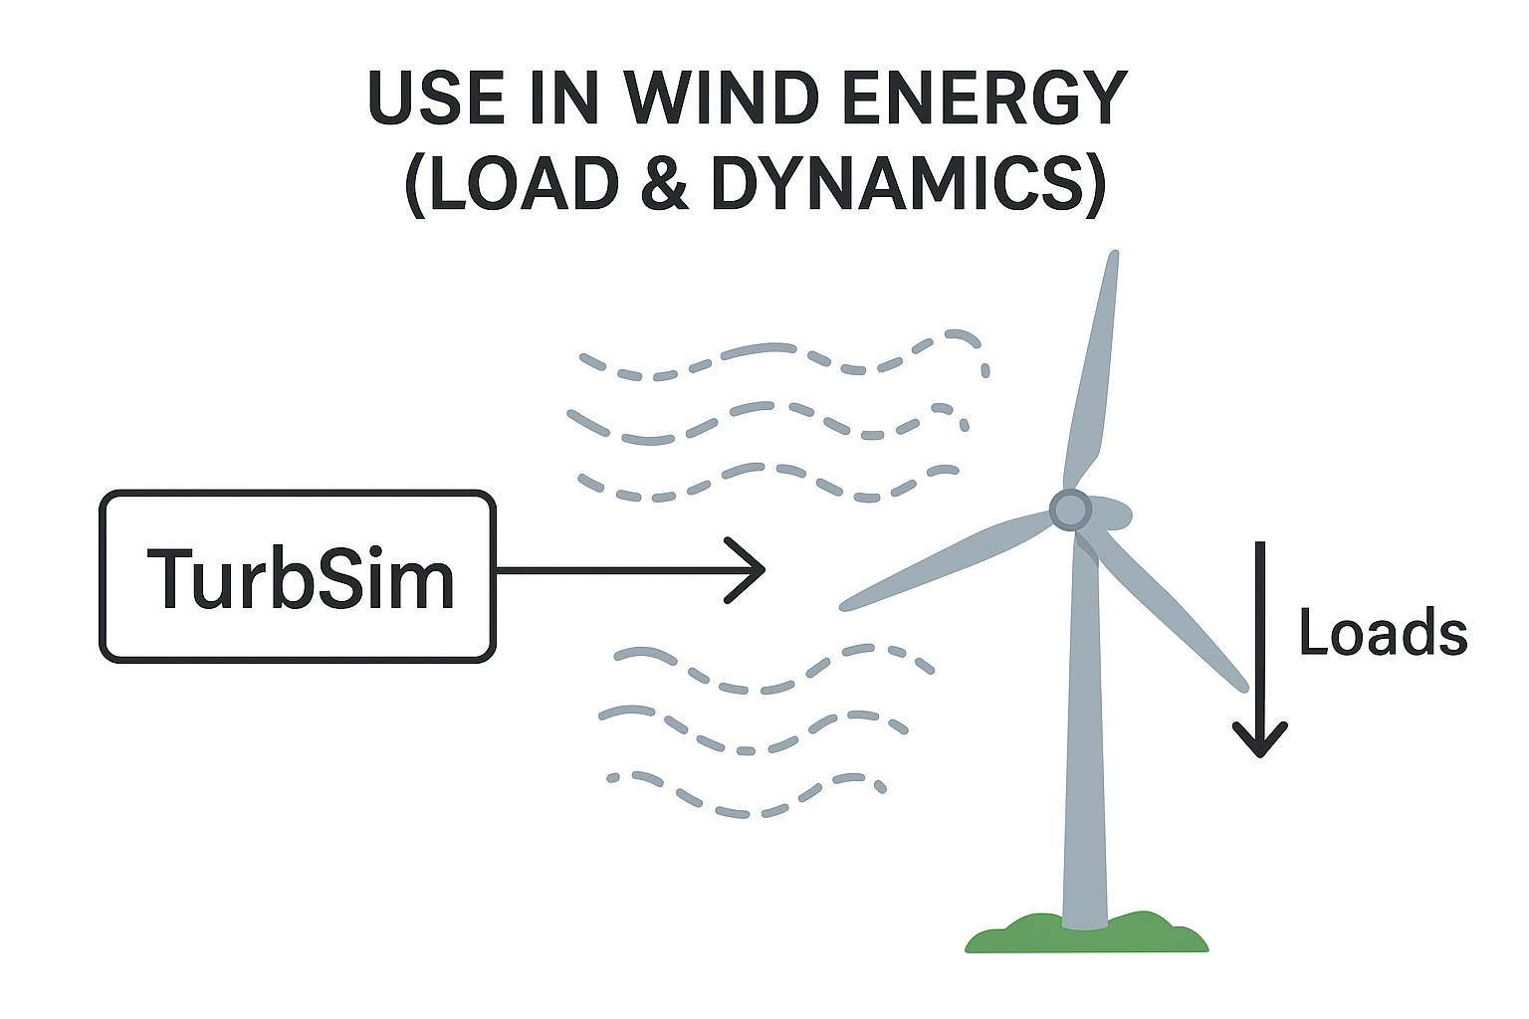
TurbSim
Turb Sim ( Turbulence Simulation )
TurbSim is a stochastic (random) wind field simulator developed by the National Renewable Energy Laboratory (NREL). It generates time-series of three-dimensional wind velocity fields that represent realistic atmospheric turbulence.
Allows to input mean wind speed, turbulence intensity, turbulence length scale, etc. into OpenFAST simulations.
07/10/2025
6
Load & Dynamics Team/ Optimus Syria

Slide 7
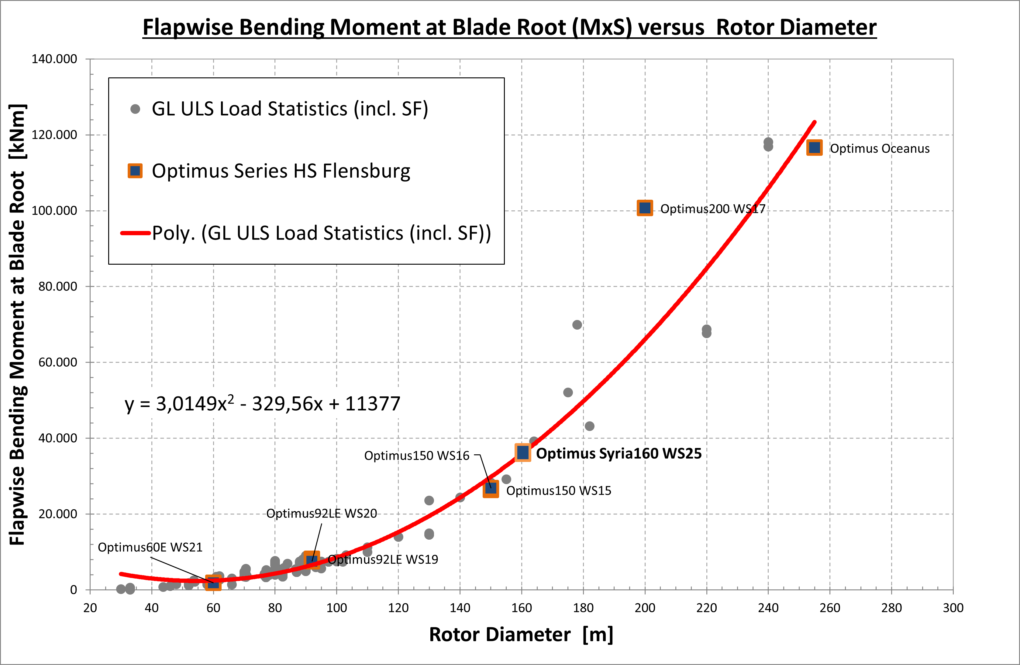
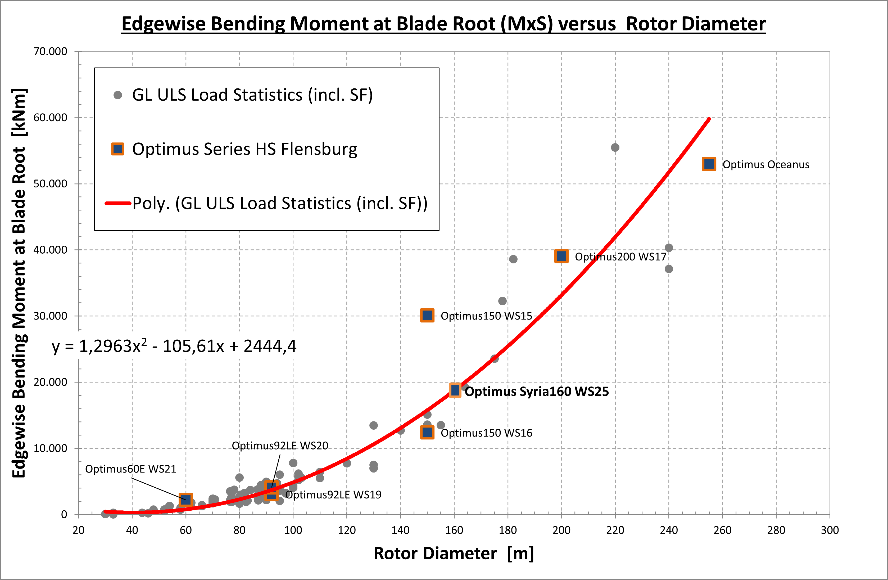
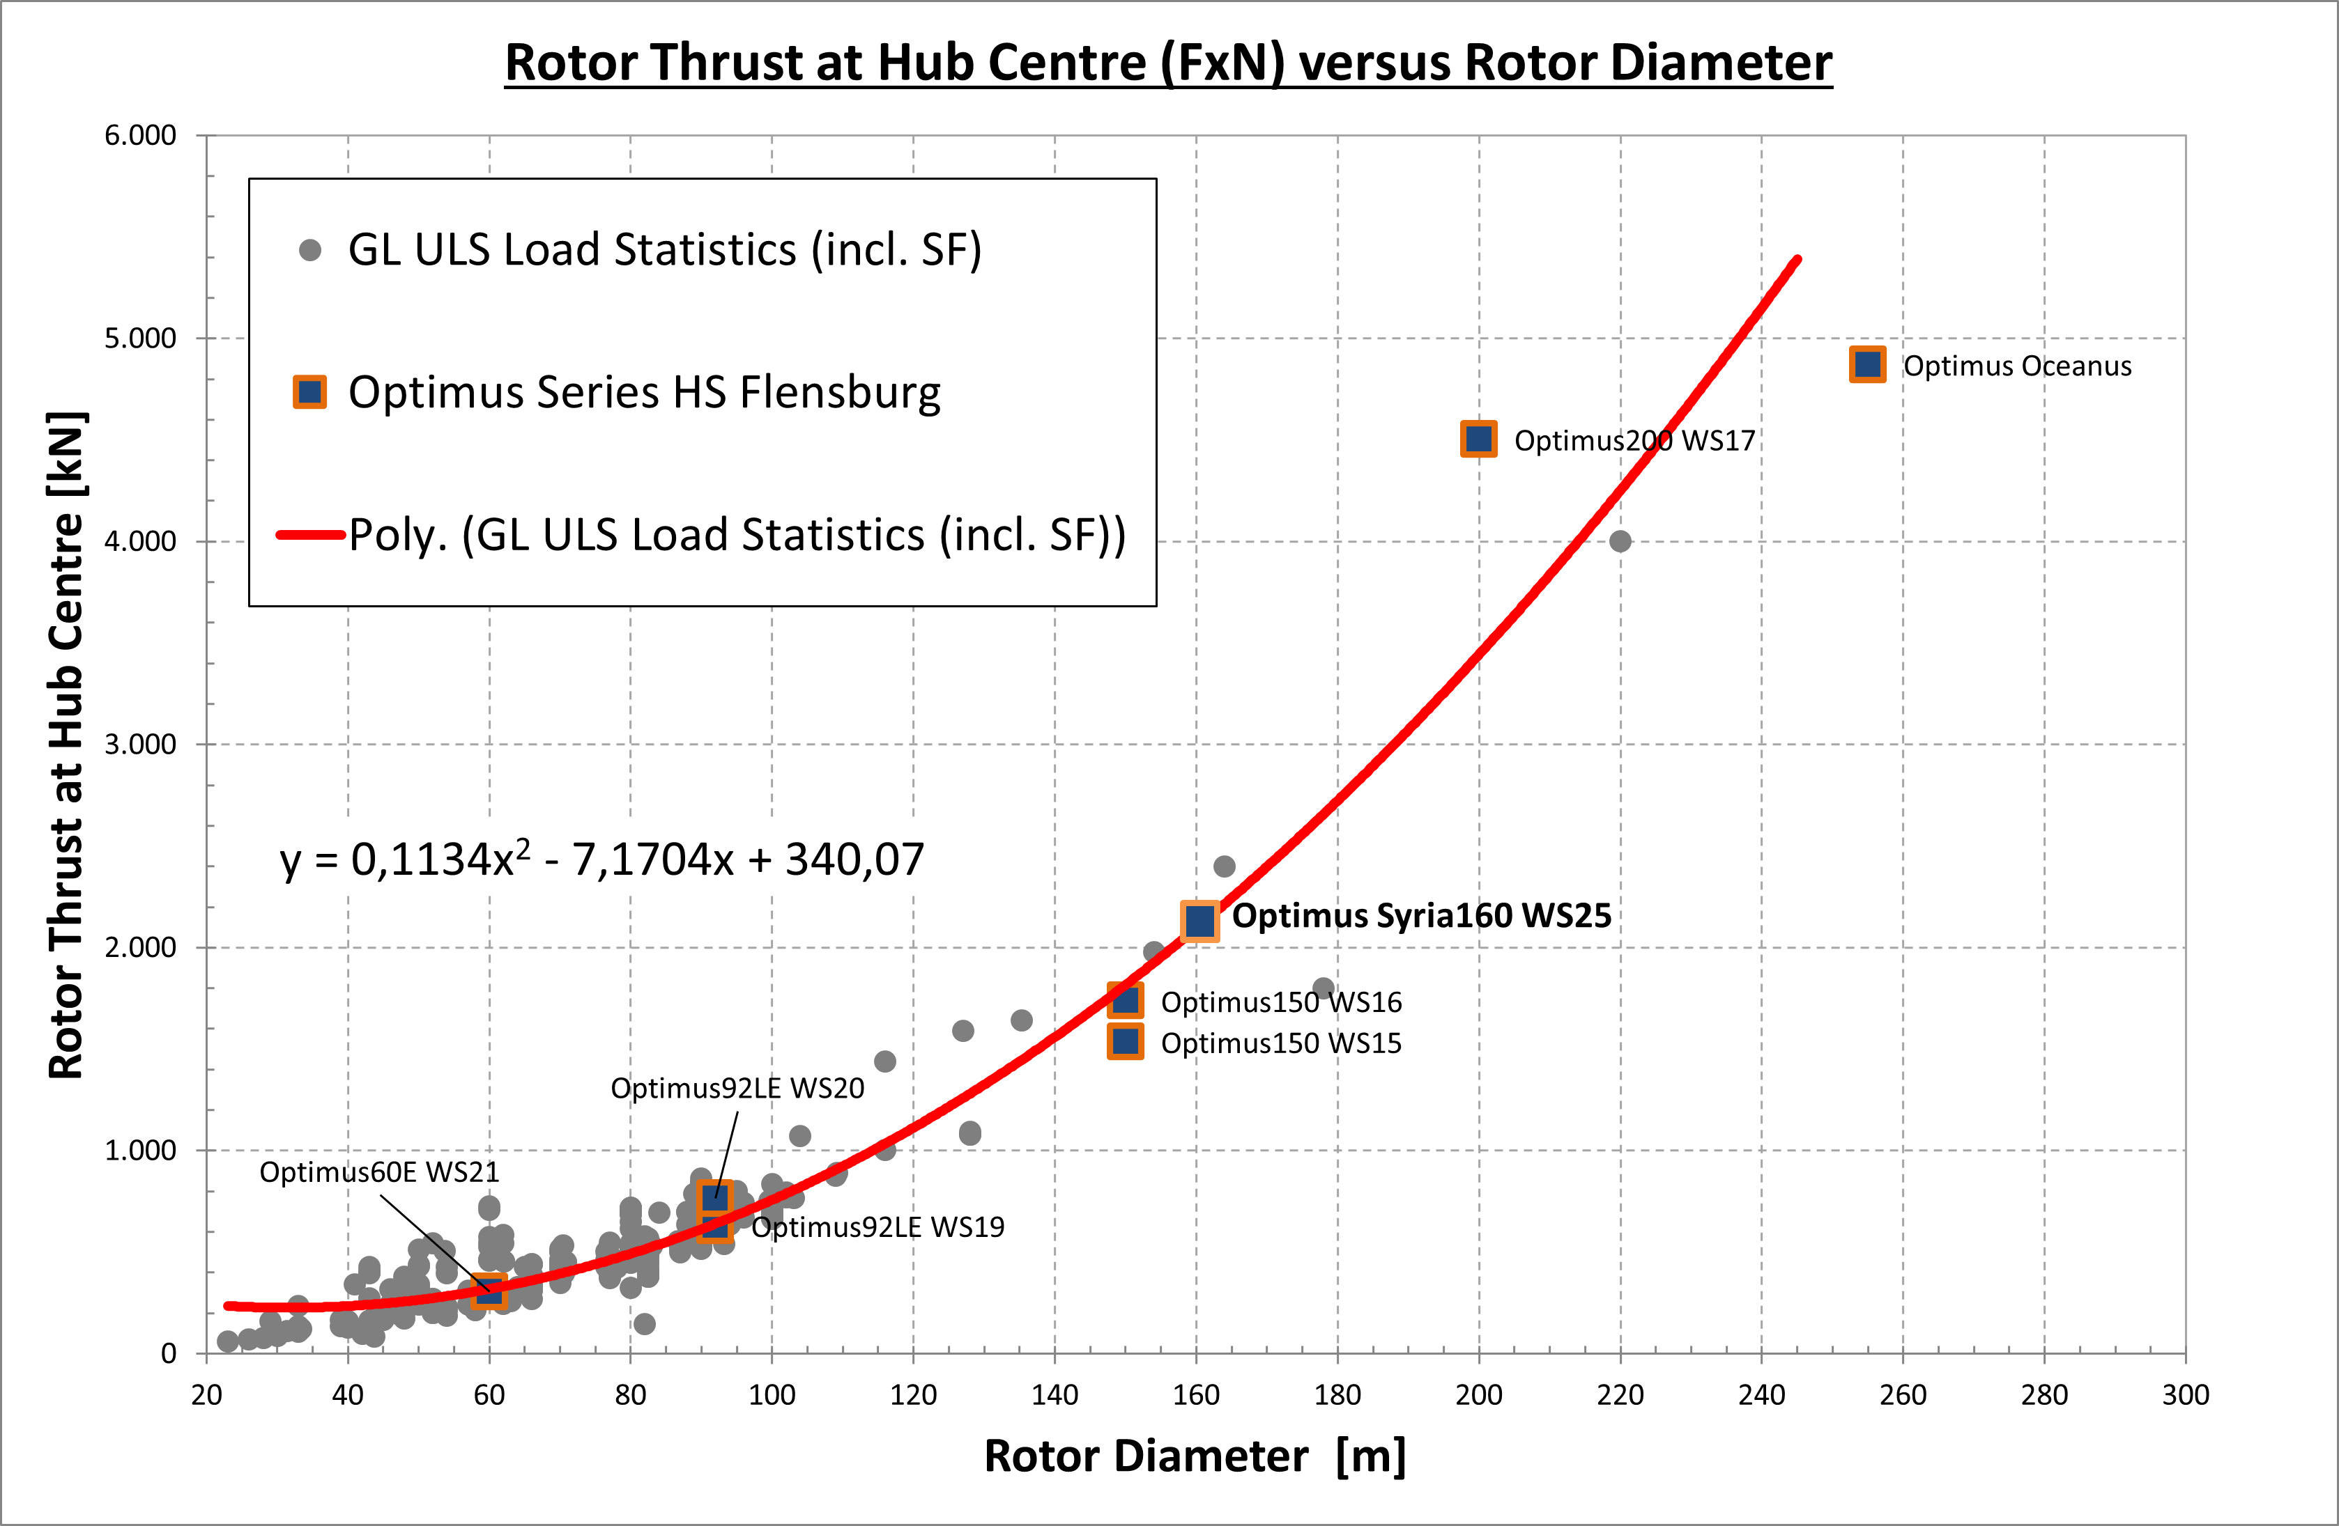
Estimated Extreme Loads for Optimus Syria
07/10/2025
7
Load & Dynamics Team/ Optimus Syria

Slide 8
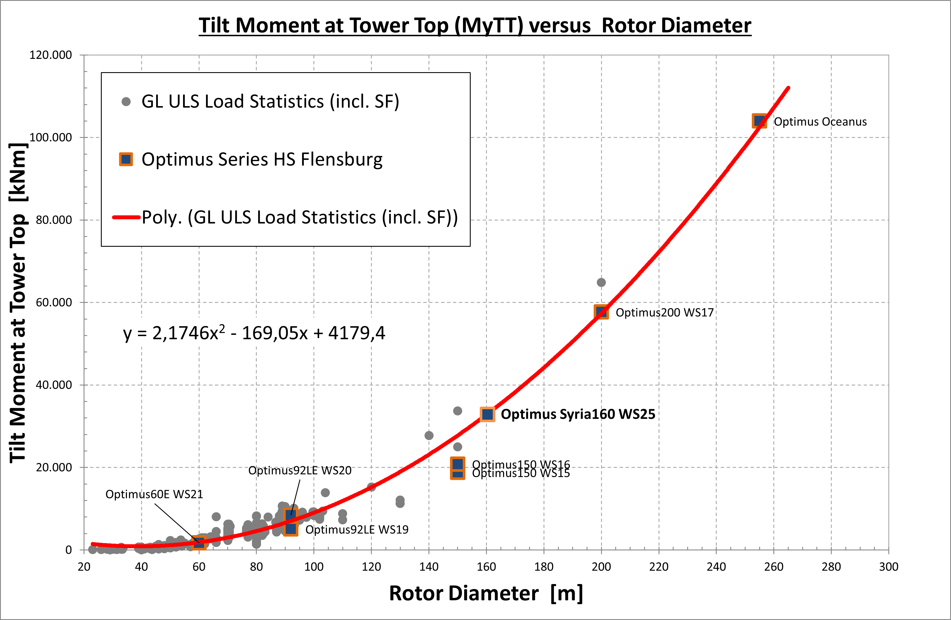
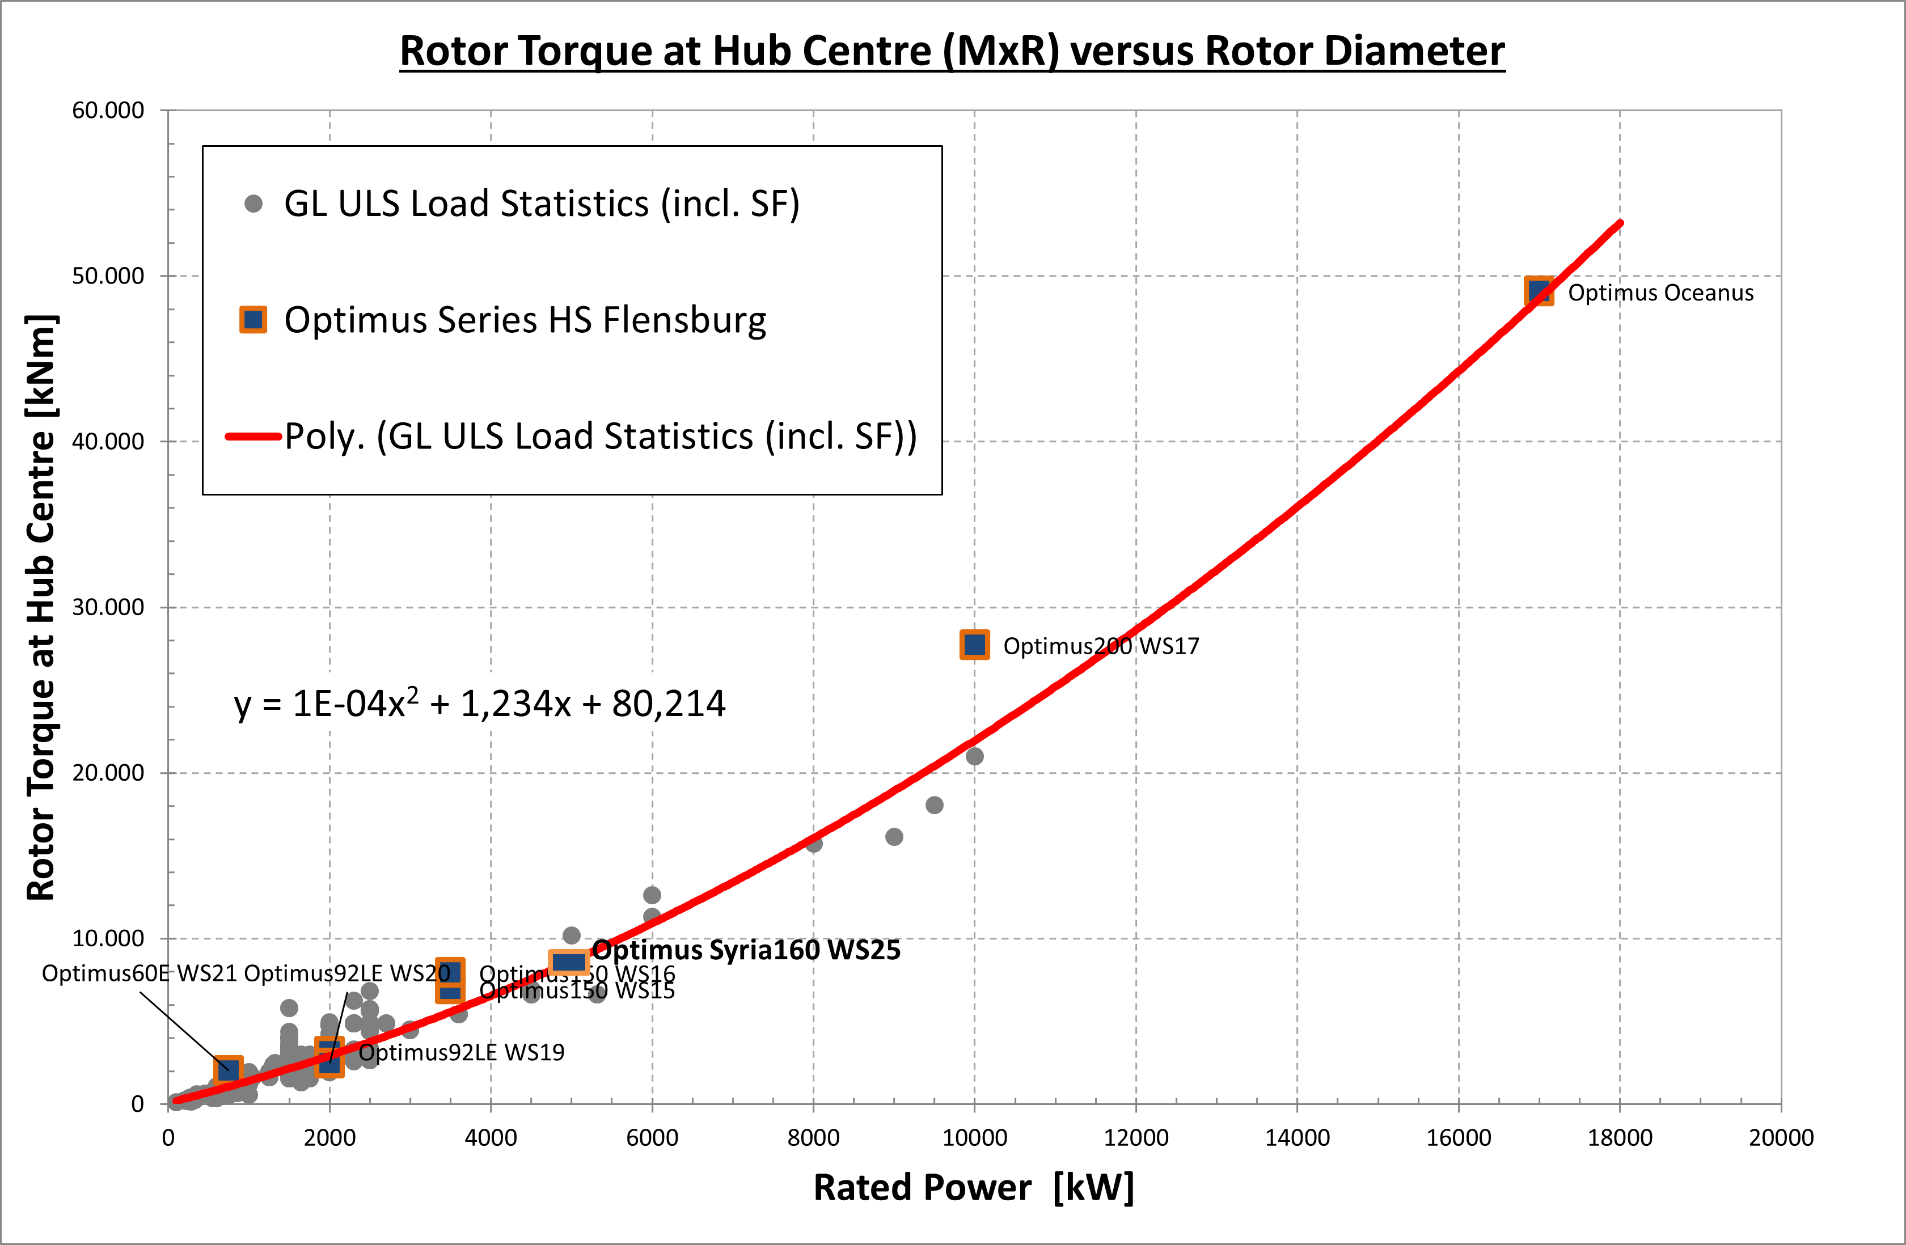
Estimated Extreme Loads for Optimus Syria
07/10/2025
8
Load & Dynamics Team/ Optimus Syria

Slide 9
Estimated Extreme Loads for Optimus Syria
All values represent extreme loads (ULS) and already include the corresponding partial safety factors (γF).
 | Blade Edge moment | Blade Flap moment | Rotor thrust | Yaw Bearing Tilt moment | Rotor torque | Tower-bottom | Diameter | Tower height | Rated Power
 | kNm | kNm | kNm | kNm | kNm | kNm | m | m | KW
Optimus150 WS15 | 30,103 | 26,341 | 1,535 | 18,793 | 6,941 | 256,308 | 150 |  | 3,500
Optimus150 WS16 | 12,413 | 26,770 | 1,737 | 20,817 | 7,925 | 284,580 | 150 | 140 | 3,500
Optimus200 WS17 | 39,052 | 100,649 | 4,503 | 57,713 | 27,729 | 681,780 | 200 | 143 | 10,000
Optimus Oceanus | 52,998 | 116,570 | 4,872 | 103,990 | 49,073 | 1,189,800 | 255 | 150 | 17,000
Optimus92LE WS19 | 3,074 | 8,184 | 630 | 5,082 | 3,194 | 64,590 | 92 | 80 | 2,000
Optimus92LE WS20 | 4,070 | 7,495 | 764 | 8,432 | 2,471 | 86,020 | 92 | 80 | 2,000
Optimus60E WS21 | 2,204 | 1,872 | 304 | 1,708 | 2,005 | 28,567 | 60 | 70 | 750
Optimus Shakti | 18,358 | 42,563 | 2,376 | 29,331 | 12,496 | 376,242 | 178 | 140 | 5,000
Optimus Syria | 18,732 | 35,830 | 2,095 | 32,786 | 8,500 | 284,186 | 160 | 120 | 5,000
07/10/2025
9
Load & Dynamics Team/ Optimus Syria

Slide 10
Connected Group & Future Plan
Feedback Control
Talked with them for Wind field
Simulation result with MatLab Simulink
Rotor Blade Design & Structure
Provided them the needed parameter for load simulations
In the next week I’ll
contact with Tower Structure team
Configure OpenFast
Create Turbulent wind Field with TurbSim
Start With Other DLC
07/10/2025
10
Load & Dynamics Team/ Optimus Syria

Slide 11
References
Load Reports of the OPTIMUS projects
Loads and site conditions for wind turbines, DNVGL-ST-437,Edition November 2016
NREL 5 MW
Load Simulation Seminar 2025 by Mr. Manjock
07/10/2025
11
Load & Dynamics Team/ Optimus Syria

